Slide 1
Interactions and Model Building Strategies

Slide 2
Announcements
Midterm in 1 week (May 10 at 1-2:50pm)
Still working on project instructions – please use similar division of work as last quarter
HW 4, Question 1, part h: Make sure you use the fitted model with Age and CPR to calculate the 10 year increase in age.
Thank you all for your patience as I catch up on our project work, midterm, and class!

Slide 3
Class 9 Learning Objectives
Determine if an additional independent variable is a not a confounder nor effect modifier, is a confounder but not effect modifier, or is an effect modifier.
Calculate and interpret odds ratios for interactions
Understand the overall steps for purposeful selection as a model building strategy
Connect these steps back to the tests of coefficients in Class 8

Slide 4
Class 9 Learning Objectives
Determine if an additional independent variable is a not a confounder nor effect modifier, is a confounder but not effect modifier, or is an effect modifier.
Calculate and interpret odds ratios for interactions
Understand the overall steps for purposeful selection as a model building strategy
Connect these steps back to the tests of coefficients in Class 8

Slide 5
Re-visit Confounding
A confounding variable, or confounder, is a factor/variable that wholly or partially accounts for the observed effect of the risk factor on the outcome
A confounder must be
related to the outcome Y, but not a consequence of Y.
related to the explanatory variable X, but not a consequence of X.
Confounder
Association
Association
Explanatory/Expos-ure Variable (X)
Association?
Outcome/Response Variable (Y)

Slide 6
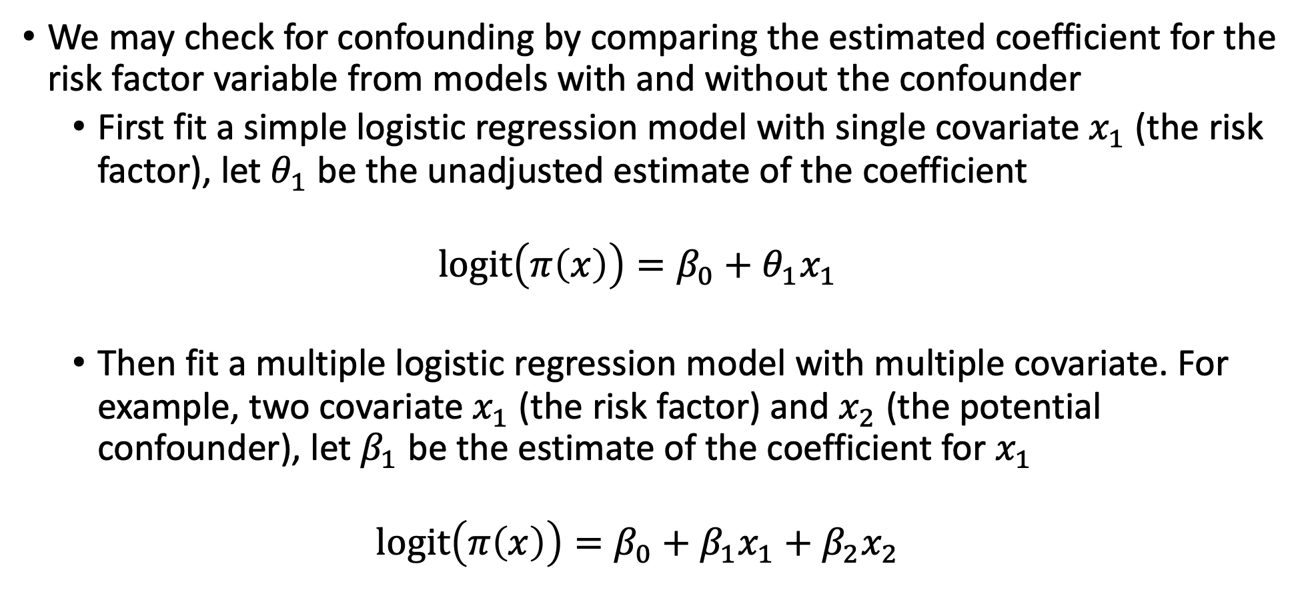
Test for Confounding (I)
We may check for confounding by comparing the estimated coefficient for the risk factor variable from models with and without the confounder
First fit a simple logistic regression model with single covariate $x_{1}$ (the risk factor), let $θ_{1}$ be the unadjusted estimate of the coefficient
$$logit\left(π\left(x\right)\right)=β_{0}+θ_{1}x_{1}$$
Then fit a multiple logistic regression model with multiple covariate. For example, two covariate $x_{1}$ (the risk factor) and $x_{2}$ (the potential confounder), let $β_{1}$ be the estimate of the coefficient for $x_{1}$
$$logit\left(π\left(x\right)\right)=β_{0}+β_{1}x_{1}+β_{2}x_{2}$$

Slide 7
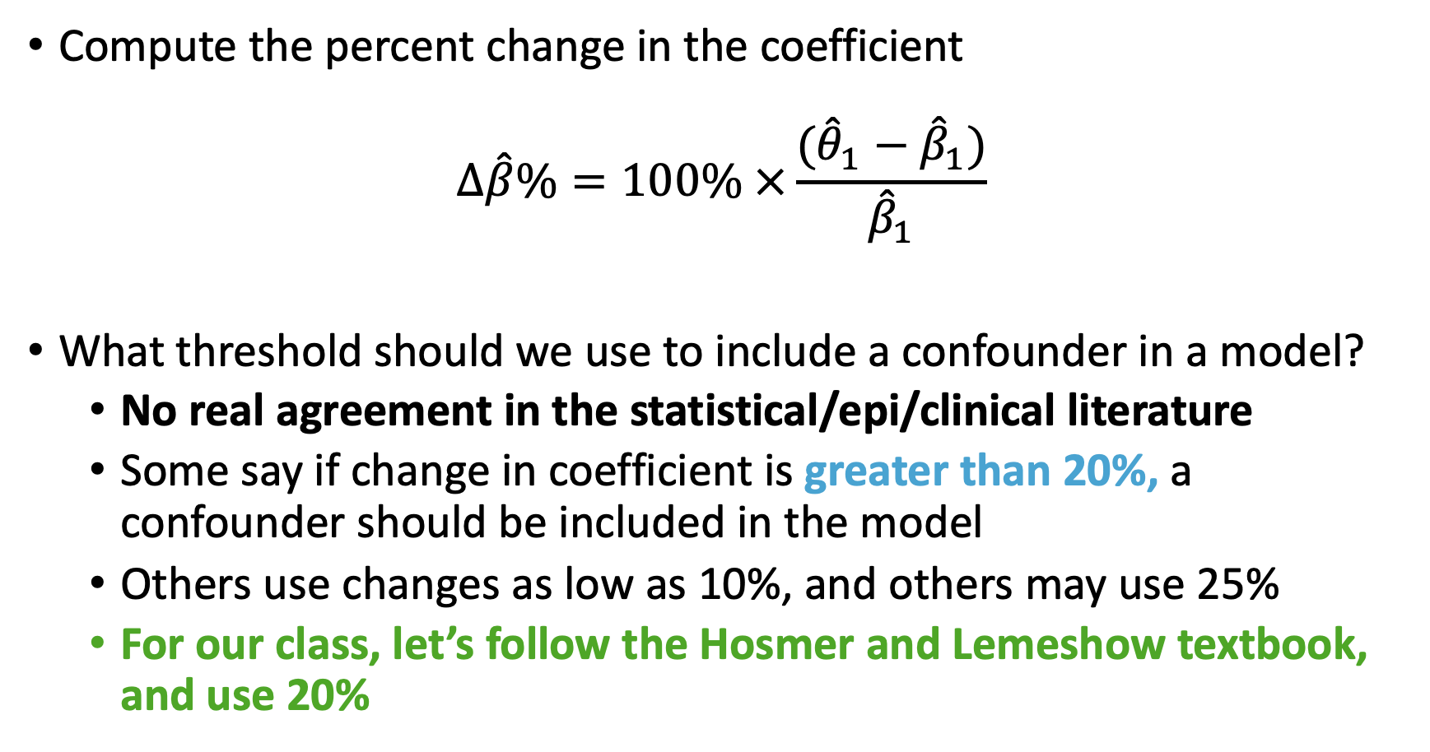
Test for Confounding (I)
Compute the percent change in the coefficient
$$Δ\hat{β}\%=100\% ×\frac{({\hat{θ}}_{1}−{\hat{β}}_{1})}{{\hat{β}}_{1}}$$
What threshold should we use to include a confounder in a model?
No real agreement in the statistical/epi/clinical literature
Some say if change in coefficient is greater than 20%, a confounder should be included in the model
Others use changes as low as 10%, and others may use 25%
For our class, let’s follow the Hosmer and Lemeshow textbook, and use 20%

Slide 8
Poll Everywhere Question 1

Slide 9
Test for Confounding (III)
We may test the significance of any variable (including confounder) using hypothesis testing (say, likelihood ratio test)
It is generally suggested to include a confounder in the model if it is statistically significantly associated with the outcome itself
A statistically insignificant confounder may stay in the model if it is determined that the change in the estimated coefficient for the risk factor with and without the risk factor is “clinically or biologically important”
Whether it reaches a desired change threshold or not!

Slide 10
Confounding vs. Interaction
Please refer to your Day 10 notes from BSTA 512/612 – lots of information about these concepts!
Confounders: The adjusted odds ratio for one variable adjusting for confounders can be quite different from unadjusted odds ratio
Adjusting for them is called controlling for confounding.
Interactions: When odds ratio for one variable is not constant over the levels of another variable, the two variables are said to have a statistical interaction (sometimes also called effect modification)
i.e.: the log odds of one variable is modified/changed with different values of the other variable
A variable is an effect modifier if it interacts with a risk factor

Slide 11
Interaction
We learned that multiple logistic regression (MLR) model can be used for adjusting for confounders
Confounders can be either categorical or continuous independent variable
The adjusted OR using MLR is often very close to the adjusted OR using Mantel-Haenszel method (Class 4)
Similarly, the single adjusted OR using MLR should ONLY be reported when there is no interaction
No interaction means the OR across strata is homogeneous

Slide 12
Example of interaction
In a cohort study of elderly people the chance of death (outcome) within 2 years was much higher for those who had previously suffered a hip fracture at the start of these 2 years, but the excess risk associated with a hip fracture was significantly higher for men than women
This is an interaction between hip fracture status (yes/no) and sex (unclear if assigned at birth or no)
Odds ratio for females > odds ratio for males
Chance of death
No
Yes
Hip fracture
Notes:
Start by showing the overall change in chance of death between no and yes, then use male vs. female!!

Slide 13
Types of Interaction (I)
No interaction and three potential effects of interaction between two covariates A and B:
No interaction between A and B (confounder with no interaction)
Unilateralism: exposure to A has no effect in the absence of exposure to B, but a considerable effect when B is present.
Synergism: the effect of A is in the same direction, but stronger in the presence of B.
Antagonism: the effect of A works in the opposite direction in the presence of B.

Slide 14
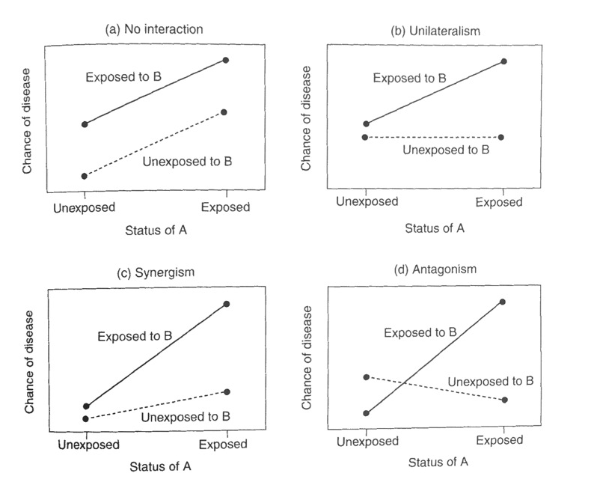
Types of Interaction (II)
Confounder, but no interaction between A and B
Exposure to A has no effect in the absence of exposure to B, but a considerable effect when B is present
Effect of A is in the same direction, but stronger in the presence of B
Effect of A works in the opposite direction in the presence of B

Slide 15
Poll Everywhere Question 2

Slide 16
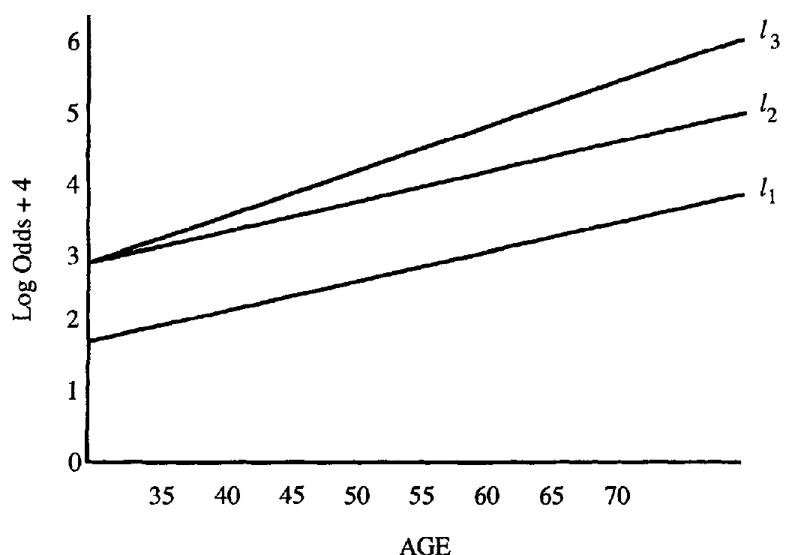
Understand the Interaction (I)
Figure plots the logits under three different models showing the presence and absence of interaction.
Response variable: CHD
Risk factor: sex
Covariate to be controlled: age
Logit for male (with interaction)
Logit for male (w/o interaction)
Logit for female

Slide 17
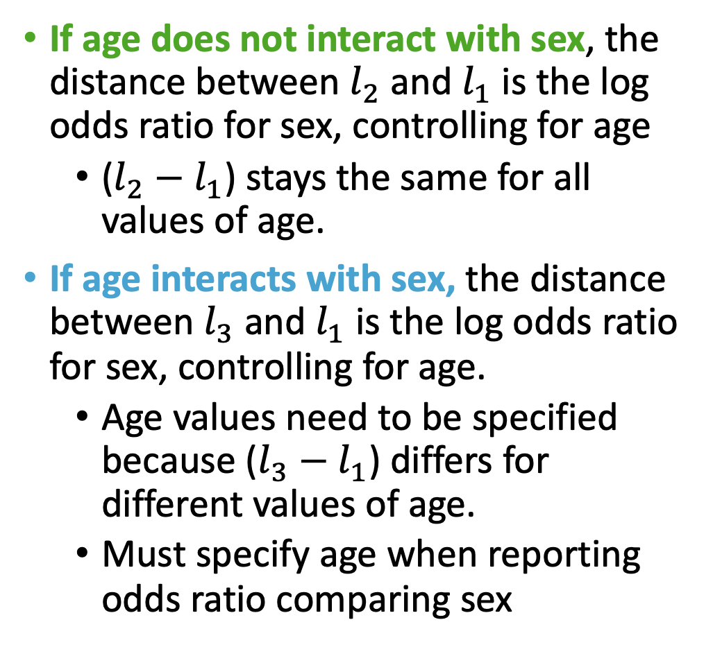
Understand the Interaction (II)
If age does not interact with sex, the distance between $l_{2}$ and $l_{1}$ is the log odds ratio for sex, controlling for age
($l_{2}−$ $l_{1}$) stays the same for all values of age.
If age interacts with sex, the distance between $l_{3}$ and $l_{1}$ is the log odds ratio for sex, controlling for age.
Age values need to be specified because ($l_{3}−$ $l_{1}$) differs for different values of age.
Must specify age when reporting odds ratio comparing sex

Slide 18
Poll Everywhere Question 3

Slide 19
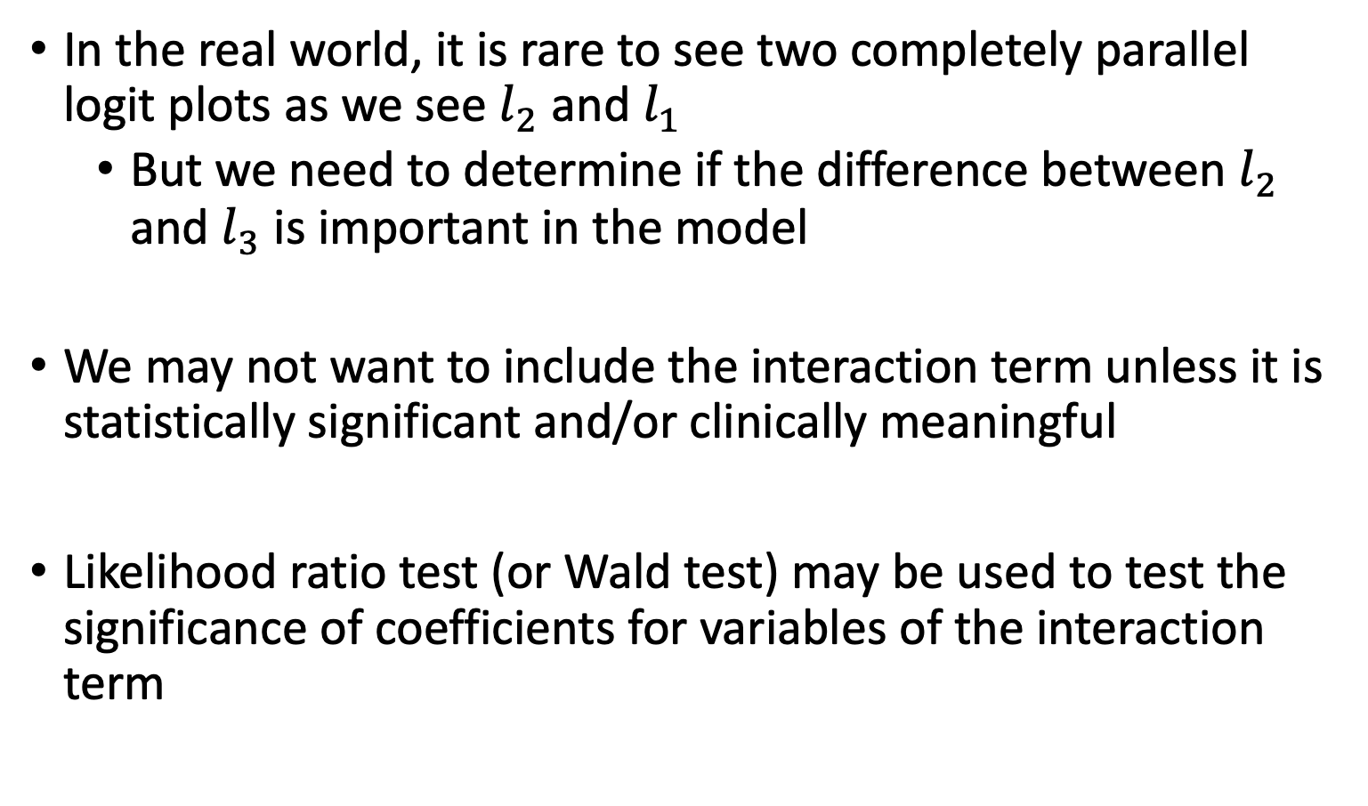
Understand the Interaction (III)
In the real world, it is rare to see two completely parallel logit plots as we see $l_{2}$ and $l_{1}$
But we need to determine if the difference between $l_{2}$ and $l_{3}$ is important in the model
We may not want to include the interaction term unless it is statistically significant and/or clinically meaningful
Likelihood ratio test (or Wald test) may be used to test the significance of coefficients for variables of the interaction term

Slide 20
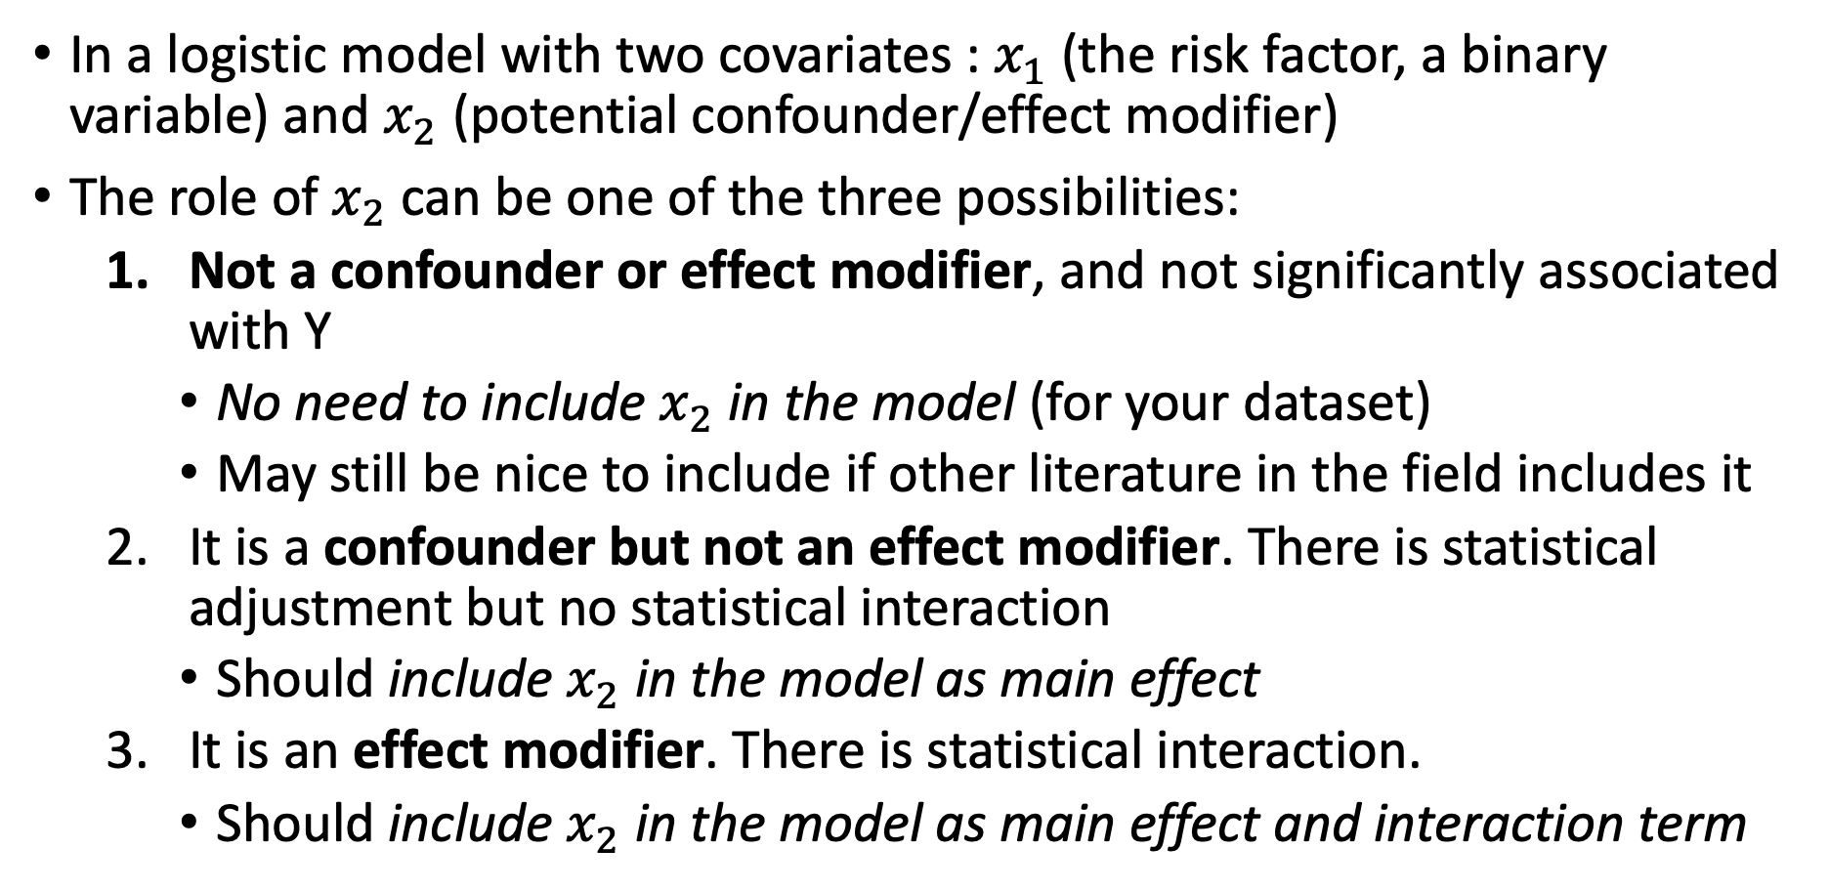
Summary
In a logistic model with two covariates : $x_{1}$(the risk factor, a binary variable) and $x_{2}$ (potential confounder/effect modifier)
The role of $x_{2}$ can be one of the three possibilities:
Not a confounder or effect modifier, and not significantly associated with Y
No need to include $x_{2}$ in the model (for your dataset)
May still be nice to include if other literature in the field includes it
It is a confounder but not an effect modifier. There is statistical adjustment but no statistical interaction
Should include $x_{2}$ in the model as main effect
It is an effect modifier. There is statistical interaction.
Should include $x_{2}$ in the model as main effect and interaction term

Slide 21
Example: GLOW Study (I)
From GLOW (Global Longitudinal Study of Osteoporosis in Women) study
Outcome variable: any fracture in the first year of follow up (FRACTURE: 0 or 1)
Risk factor/variable of interest: history of prior fracture (PRIORFRAC: 0 or 1)
Potential confounder or effect modifier: age (AGE, a continuous variable)

Slide 22
Example: GLOW Study (II)
Back in BSTA 512/612, we could visual the data to get a sense of the interaction before fitting a model
With a binary outcome, this is a little harder
We could use a contingency table or plot proportions of the outcome
Hard to do this when our potential confounder or effect modifier is continuous

Slide 23
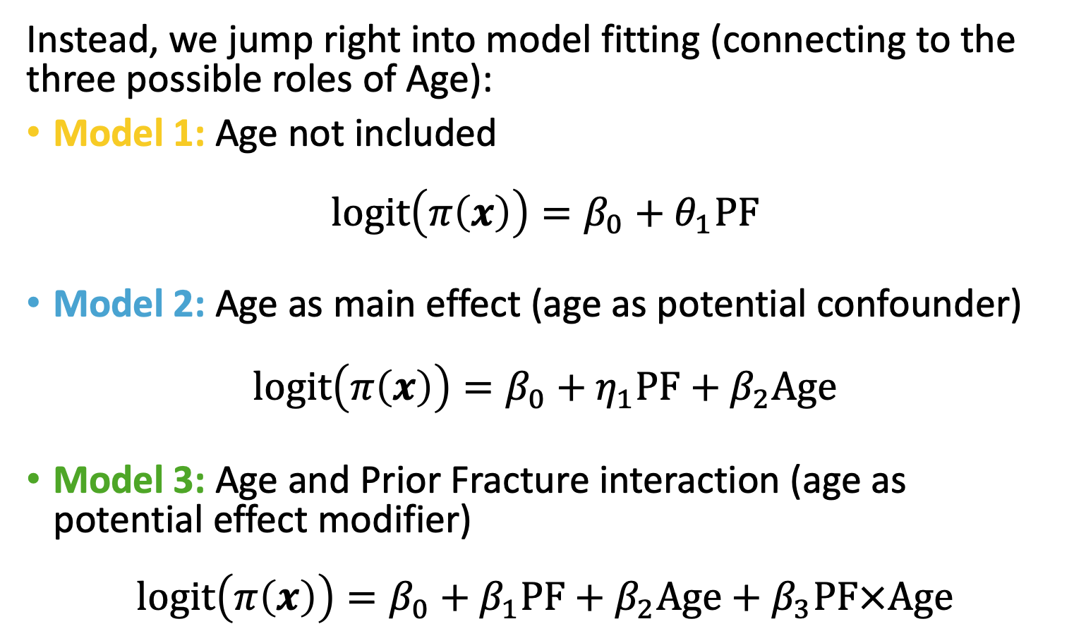
Example: GLOW Study (III)
Instead, we jump right into model fitting (connecting to the three possible roles of Age):
Model 1: Age not included
$$logit\left(π\left(x\right)\right)=β_{0}+θ_{1}PF$$
Model 2: Age as main effect (age as potential confounder)
$$logit\left(π\left(x\right)\right)=β_{0}+η_{1}PF+β_{2}Age$$
Model 3: Age and Prior Fracture interaction (age as potential effect modifier)
$$logit\left(π\left(x\right)\right)=β_{0}+β_{1}PF+β_{2}Age+β_{3}PF×Age$$

Slide 24
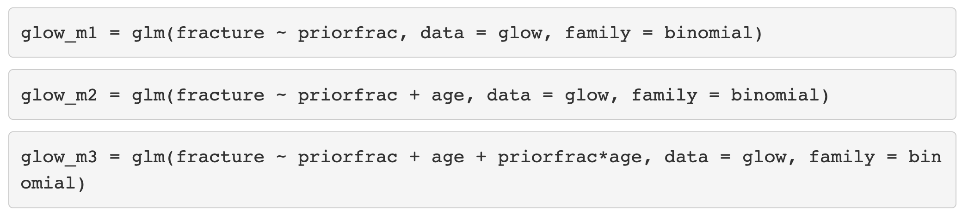
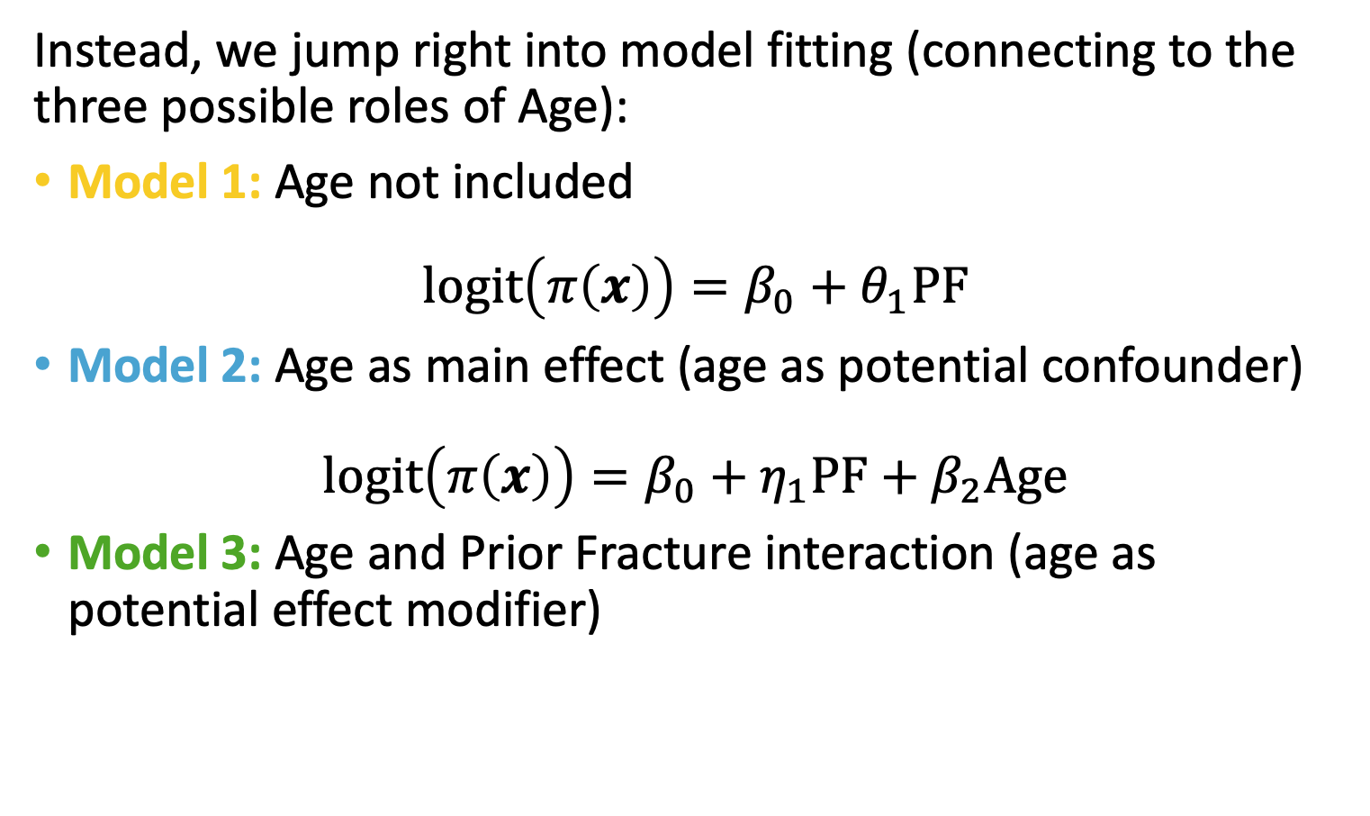
Example: GLOW Study (III)
Instead, we jump right into model fitting (connecting to the three possible roles of Age):
Model 1: Age not included
$$logit\left(π\left(x\right)\right)=β_{0}+θ_{1}PF$$
Model 2: Age as main effect (age as potential confounder)
$$logit\left(π\left(x\right)\right)=β_{0}+η_{1}PF+β_{2}Age$$
Model 3: Age and Prior Fracture interaction (age as potential effect modifier)
$$logit\left(π\left(x\right)\right)=β_{0}+β_{1}PF+β_{2}Age+β_{3}PF×Age$$

Slide 25
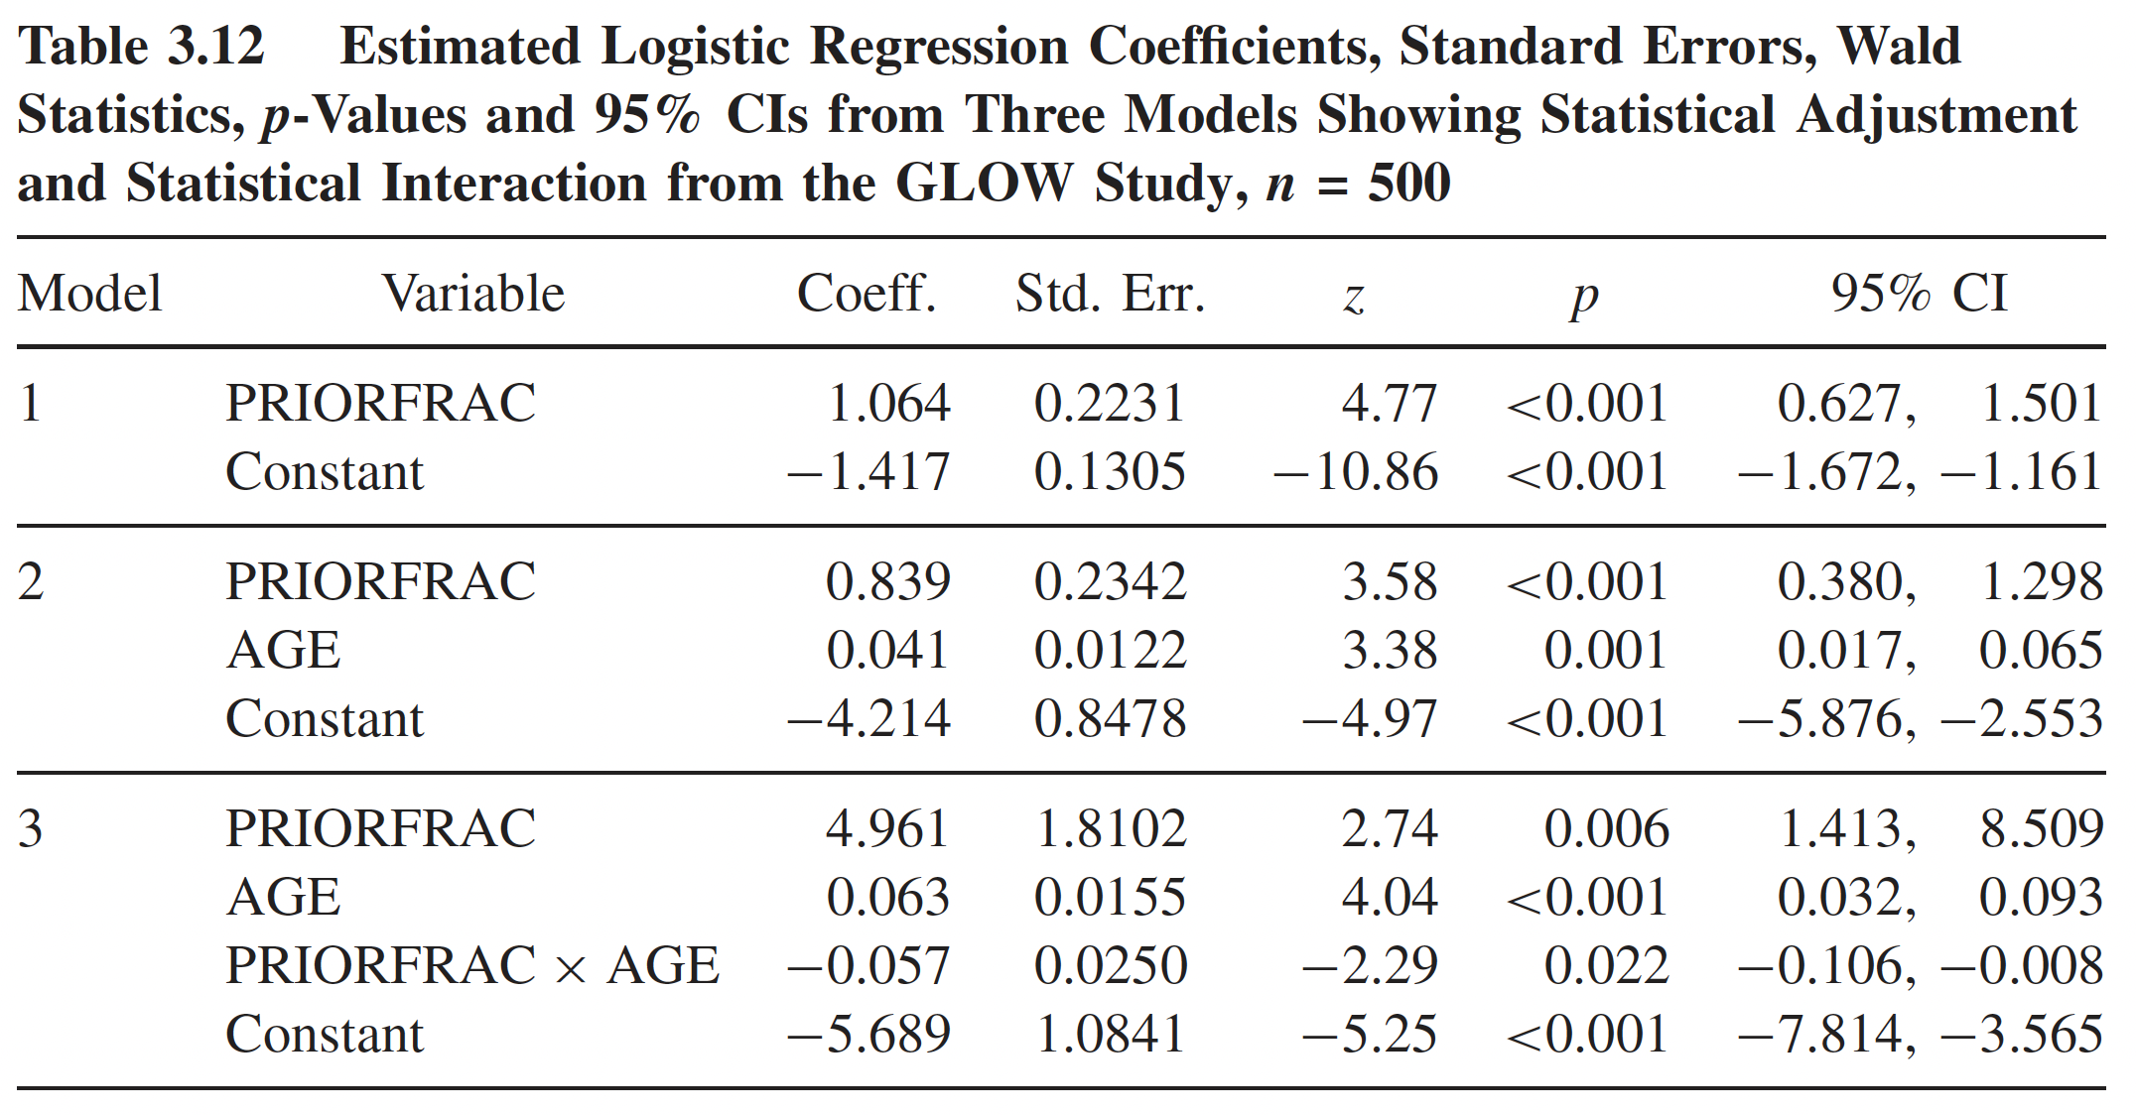



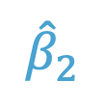



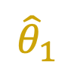
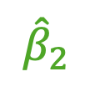
Example: GLOW Model Coefficient Estimates
$${\hat{θ}}_{1}$$
$${\hat{β}}_{0}$$
$${\hat{η}}_{1}$$
$${\hat{β}}_{2}$$
$${\hat{β}}_{0}$$
$${\hat{β}}_{1}$$
$${\hat{β}}_{2}$$
$${\hat{β}}_{3}$$
$${\hat{β}}_{0}$$
Table from Hosmer & Lemeshow, page 72

Slide 26
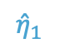
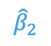
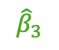
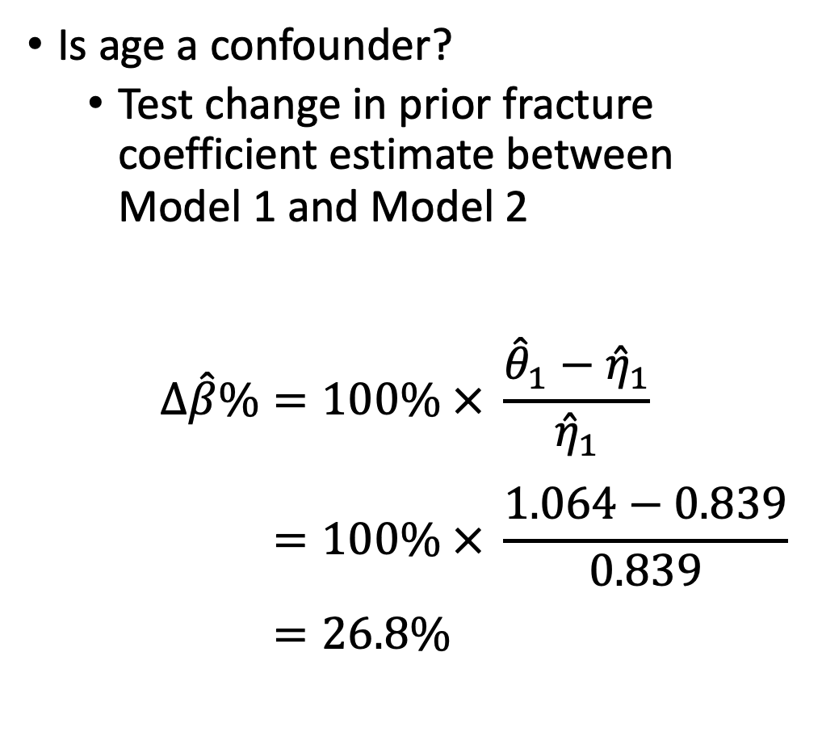

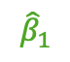
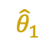
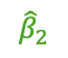


Example: GLOW – Age confounder? (I)
Is age a confounder?
Test change in prior fracture coefficient estimate between Model 1 and Model 2
$$Δ\hat{β}\%=100\% × \frac{{\hat{θ}}_{1}−{\hat{η}}_{1}}{{\hat{η}}_{1}} \\ =100\% × \frac{1.064−0.839}{0.839} \\ =26.8\%$$
$${\hat{θ}}_{1}$$
$${\hat{β}}_{0}$$
$${\hat{η}}_{1}$$
$${\hat{β}}_{2}$$
$${\hat{β}}_{0}$$
$${\hat{β}}_{1}$$
$${\hat{β}}_{2}$$
$${\hat{β}}_{3}$$
$${\hat{β}}_{0}$$
Table from Hosmer & Lemeshow, page 72

Slide 27
Example: GLOW – Age confounder? (II)
Is age a confounder?
Test change in prior fracture coefficient estimate between Model 1 and Model 2
Coefficient for prior fracture from the univariable model overestimates the effect by 26.8%. Hence, at this point, we could conclude that age is a confounder and including age in the model provides an important statistical adjustment to the effect of prior fracture.
$${\hat{θ}}_{1}$$
$${\hat{β}}_{0}$$
$${\hat{η}}_{1}$$
$${\hat{β}}_{2}$$
$${\hat{β}}_{0}$$
$${\hat{β}}_{1}$$
$${\hat{β}}_{2}$$
$${\hat{β}}_{3}$$
$${\hat{β}}_{0}$$
Table from Hosmer & Lemeshow, page 72

Slide 28
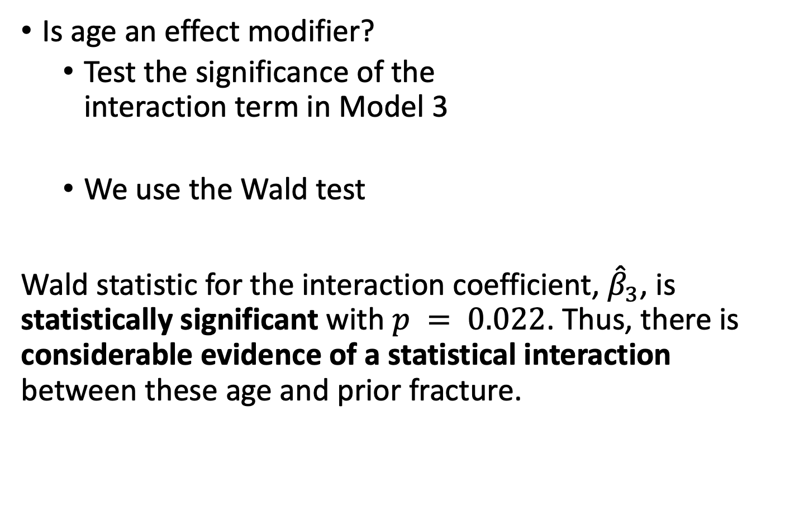
Example: GLOW – Age effect modifier? (I)
Is age an effect modifier?
Test the significance of the interaction term in Model 3
We use the Wald test
Wald statistic for the interaction coefficient, ${\hat{β}}_{3}$, is statistically significant with $p = 0.022$. Thus, there is considerable evidence of a statistical interaction between these age and prior fracture.
$${\hat{θ}}_{1}$$
$${\hat{β}}_{0}$$
$${\hat{η}}_{1}$$
$${\hat{β}}_{2}$$
$${\hat{β}}_{0}$$
$${\hat{β}}_{1}$$
$${\hat{β}}_{2}$$
$${\hat{β}}_{3}$$
$${\hat{β}}_{0}$$
Table from Hosmer & Lemeshow, page 72

Slide 29
Poll Everywhere Question 4

Slide 30
Class 9 Learning Objectives
Determine if an additional independent variable is a not a confounder nor effect modifier, is a confounder but not effect modifier, or is an effect modifier.
Calculate and interpret odds ratios for interactions
Understand the overall steps for purposeful selection as a model building strategy
Connect these steps back to the tests of coefficients in Class 8

Slide 31
Example: GLOW study (IV)
Age is an effect modifier (and possibly also a confounder)
When a covariate is an effect modifier, its status as a confounder is of secondary importance since the estimate of the effect of the risk factor depends on the specific value of the covariate
Must summarize the effect of prior fracture by age
Cannot summarize as a single (log) odds ratio

Slide 32
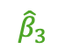
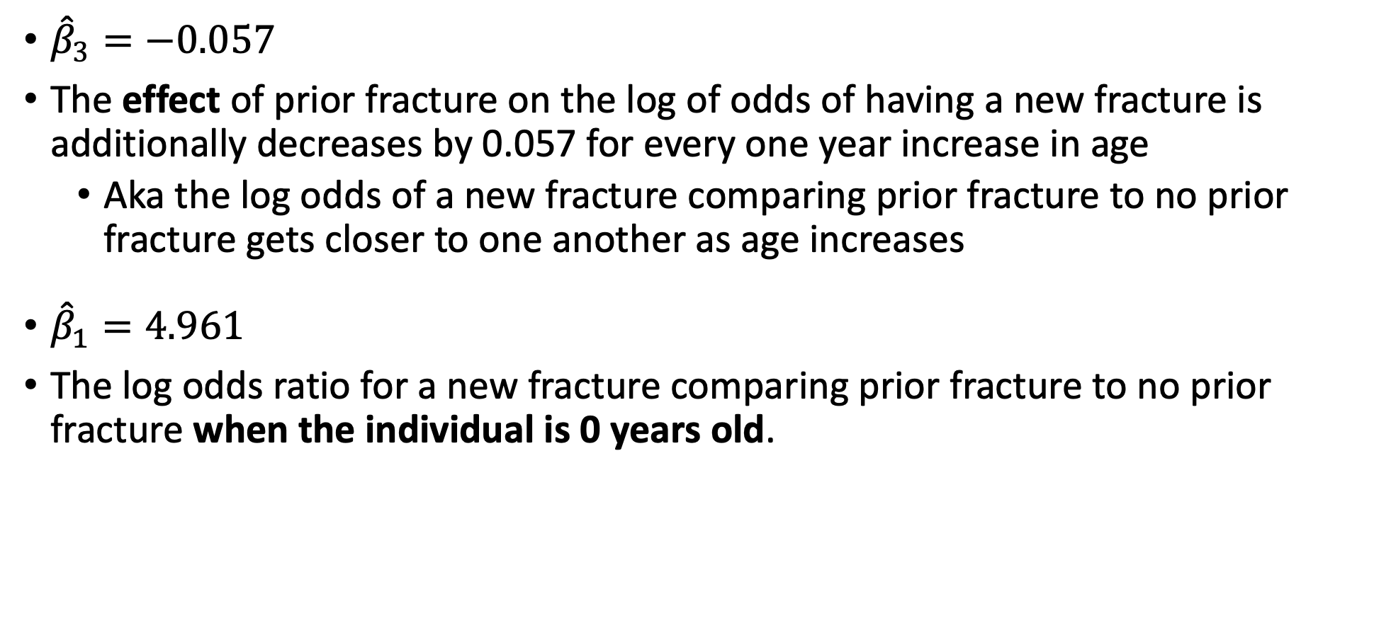
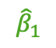
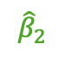

Example: GLOW – Interaction interpretation
$${\hat{β}}_{1}$$
$${\hat{β}}_{2}$$
$${\hat{β}}_{3}$$
$${\hat{β}}_{0}$$
${\hat{β}}_{3}=−0.057$
The effect of prior fracture on the log of odds of having a new fracture is additionally decreases by 0.057 for every one year increase in age
Aka the log odds of a new fracture comparing prior fracture to no prior fracture gets closer to one another as age increases
${\hat{β}}_{1}=4.961$
The log odds ratio for a new fracture comparing prior fracture to no prior fracture when the individual is 0 years old.

Slide 33
Poll Everywhere Question 5

Slide 34
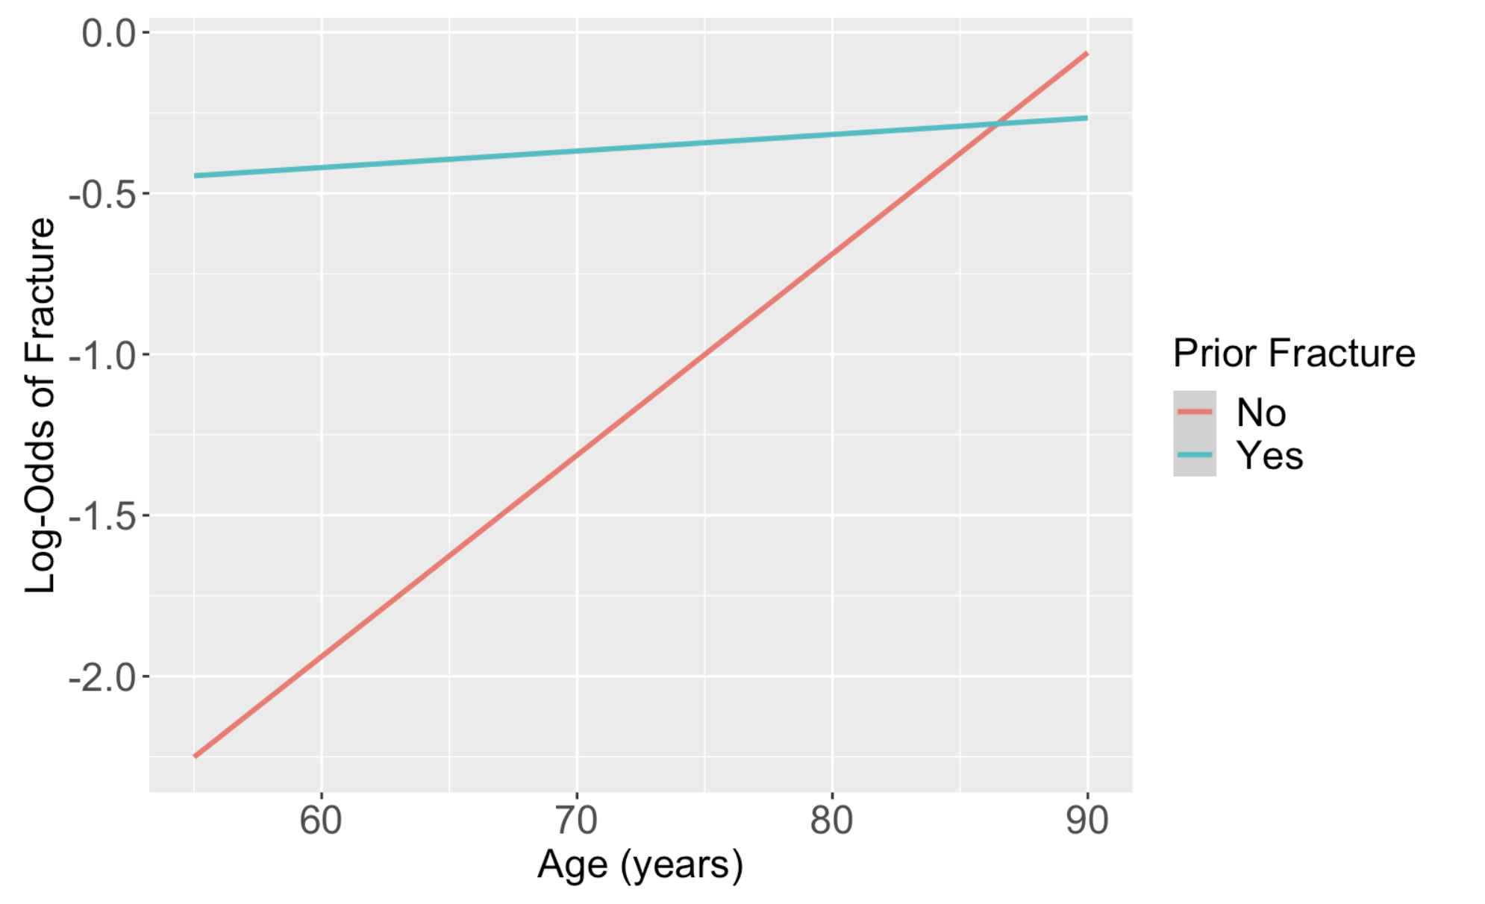
Graphically Showing Interaction
One easy way to see the nature of the interaction between F and X is to plot the two logit functions
Using the GLOW fracture example:

Slide 35
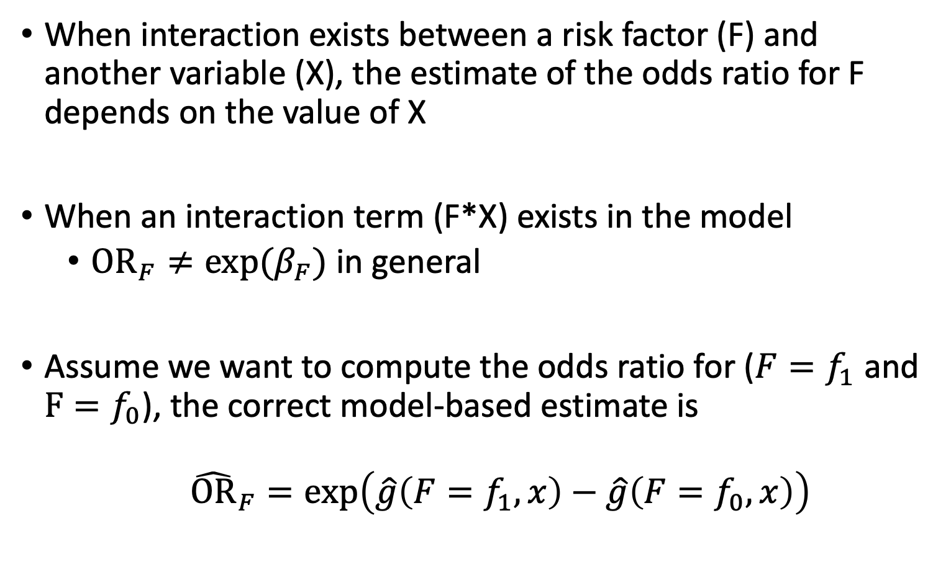
Odds Ratio in the Presence of Interaction (I)
When interaction exists between a risk factor (F) and another variable (X), the estimate of the odds ratio for F depends on the value of X
When an interaction term (F*X) exists in the model
$OR_{F}≠exp⁡(β_{F})$ in general
Assume we want to compute the odds ratio for ($F=f_{1}$ and $F=f_{0}$), the correct model-based estimate is
${\hat{OR}}_{F}=\exp\left(\hat{g}\left(F=f_{1},x\right)−\hat{g}\left(F=f_{0},x\right)\right)$

Slide 36
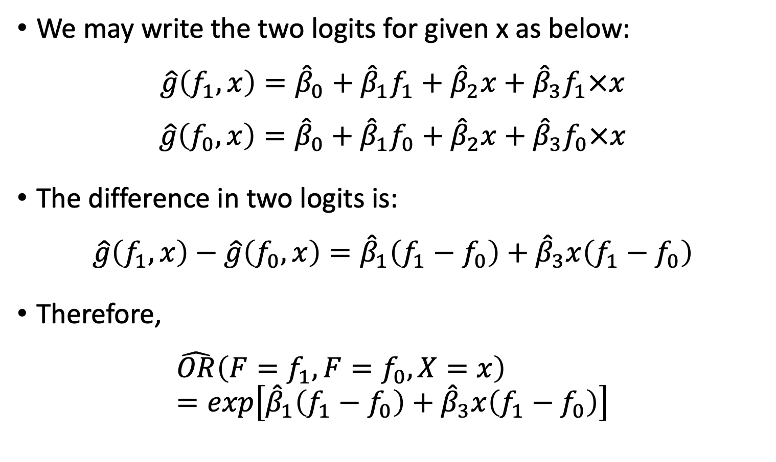
Odds Ratio in the Presence of Interaction (II)
We may write the two logits for given x as below:
$$\hat{g}\left(f_{1},x\right)={\hat{β}}_{0}+{\hat{β}}_{1}f_{1}+{\hat{β}}_{2}x+{\hat{β}}_{3}f_{1}×x$$
$$\hat{g}\left(f_{0},x\right)={\hat{β}}_{0}+{\hat{β}}_{1}f_{0}+{\hat{β}}_{2}x+{\hat{β}}_{3}f_{0}×x$$
The difference in two logits is:
$$\hat{g}\left(f_{1},x\right)−\hat{g}\left(f_{0},x\right)={\hat{β}}_{1}\left(f_{1}−f_{0}\right)+{\hat{β}}_{3}x\left(f_{1}−f_{0}\right)$$
Therefore,
$$\hat{OR}\left(F=f_{1},F=f_{0},X=x\right)=exp\left[{\hat{β}}_{1}\left(f_{1}−f_{0}\right)+{\hat{β}}_{3}x\left(f_{1}−f_{0}\right)\right]$$

Slide 37
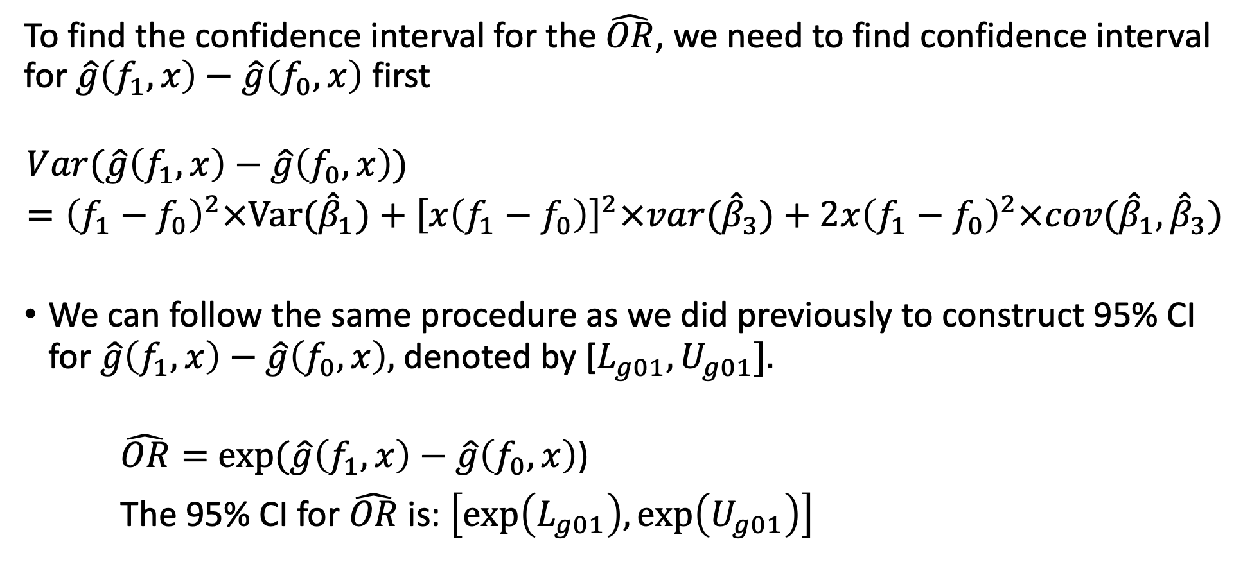
Odds Ratio in the Presence of Interaction (III)
To find the confidence interval for the $\hat{OR}$, we need to find confidence interval for $\hat{g}\left(f_{1},x\right)−\hat{g}\left(f_{0},x\right)$ first
$$Var(\hat{g}\left(f_{1},x\right)−\hat{g}\left(f_{0},x\right))={\left(f_{1}−f_{0}\right)}^{2}×Var({\hat{β}}_{1})+{\left[x\left(f_{1}−f_{0}\right)\right]}^{2}×var({\hat{β}}_{3})+2x{\left(f_{1}−f_{0}\right)}^{2}×cov({\hat{β}}_{1},{\hat{β}}_{3})$$
We can follow the same procedure as we did previously to construct 95% CI for $\hat{g}\left(f_{1},x\right)−\hat{g}\left(f_{0},x\right),$denoted by [$L_{g01}, U_{g01}].$
$\hat{OR}=$ $exp⁡(\hat{g}\left(f_{1},x\right)−\hat{g}\left(f_{0},x\right)$)
The 95% CI for $\hat{OR}$ is: $\left[exp\left(L_{g01}\right),\exp\left(U_{g01}\right)\right]$

Slide 38
Example: GLOW – Computing OR under interaction
Step 1: The two sets of values of the covariates are (priorfrac = 1, Age = a) compared to (priorfrac = 0, Age = a)
Step 2: Substituting these values into the general expression
Step 3: Taking the difference in the two functions
Step 4: Exponentiating the result

Slide 39
Example: GLOW – Step 1
Step 1: The two sets of values of the covariates are (priorfrac = 1, Age = a) compared to (priorfrac = 0, Age = a)

Slide 40
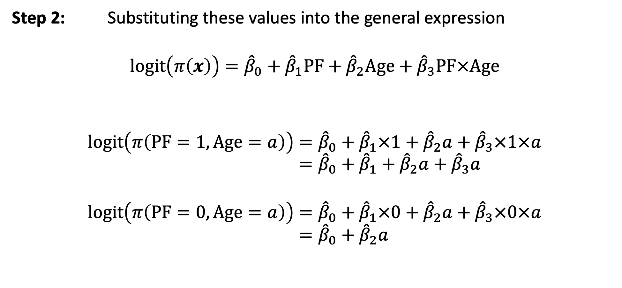
Example: GLOW – Step 2
Step 2: Substituting these values into the general expression
$$logit\left(π\left(x\right)\right)={\hat{β}}_{0}+{\hat{β}}_{1}PF+{\hat{β}}_{2}Age+{\hat{β}}_{3}PF×Age$$
$$logit\left(π\left(PF=1, Age=a\right)\right)={\hat{β}}_{0}+{\hat{β}}_{1}×1+{\hat{β}}_{2}a+{\hat{β}}_{3}×1×a \\ ={\hat{β}}_{0}+{\hat{β}}_{1}+{\hat{β}}_{2}a+{\hat{β}}_{3}a$$
$$logit\left(π\left(PF=0, Age=a\right)\right)={\hat{β}}_{0}+{\hat{β}}_{1}×0+{\hat{β}}_{2}a+{\hat{β}}_{3}×0×a \\ ={\hat{β}}_{0}+{\hat{β}}_{2}a$$

Slide 41
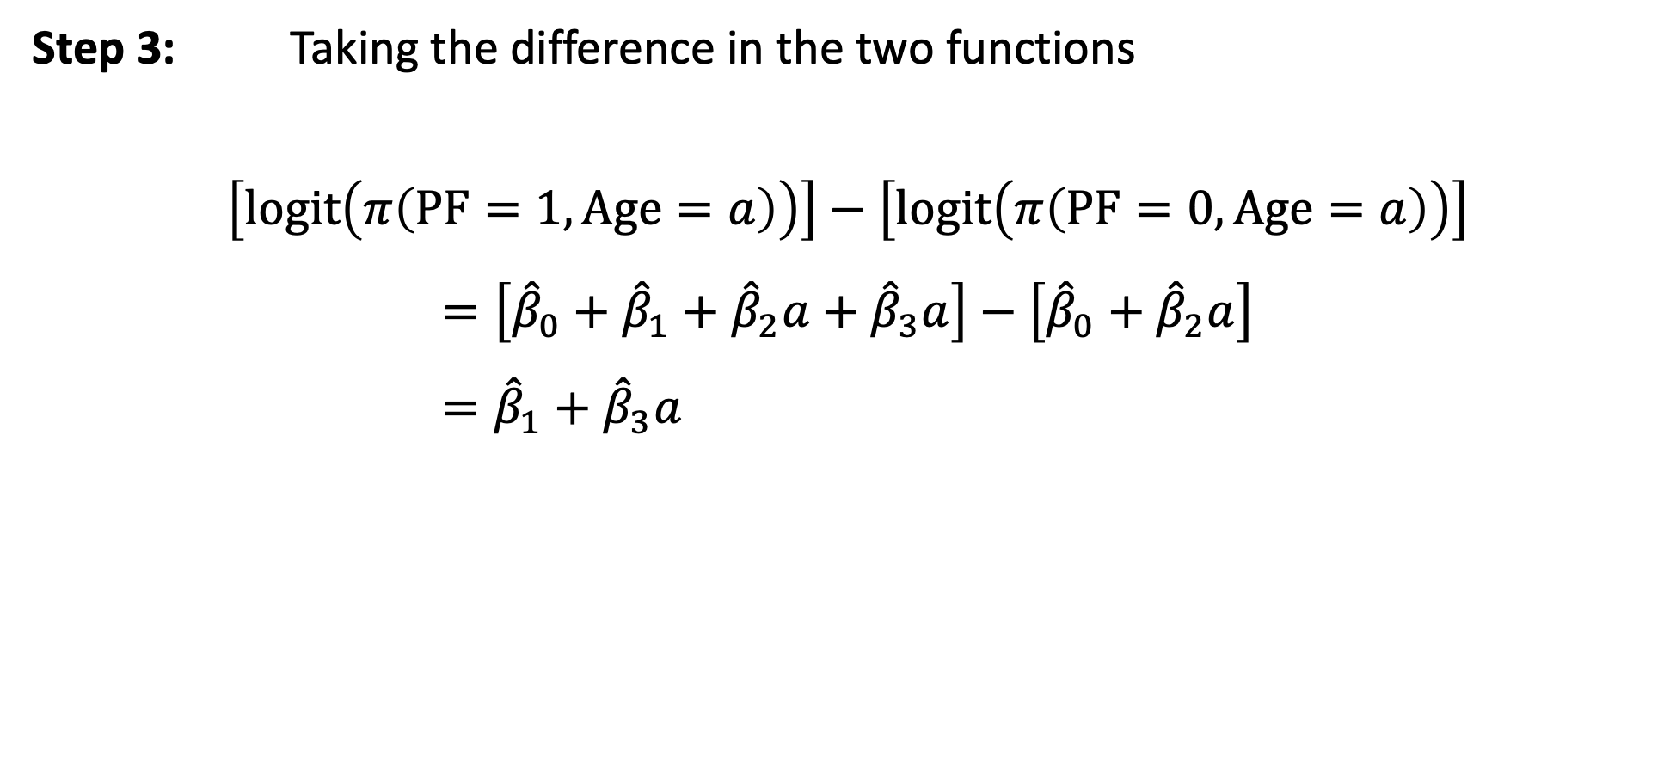
Example: GLOW – Step 3
Step 3: Taking the difference in the two functions
$$\left[logit\left(π\left(PF=1, Age=a\right)\right)\right]−\left[logit\left(π\left(PF=0, Age=a\right)\right)\right]$$
$$=\left[{\hat{β}}_{0}+{\hat{β}}_{1}+{\hat{β}}_{2}a+{\hat{β}}_{3}a\right]−\left[{\hat{β}}_{0}+{\hat{β}}_{2}a\right] \\ ={\hat{β}}_{1}+{\hat{β}}_{3}a$$

Slide 42
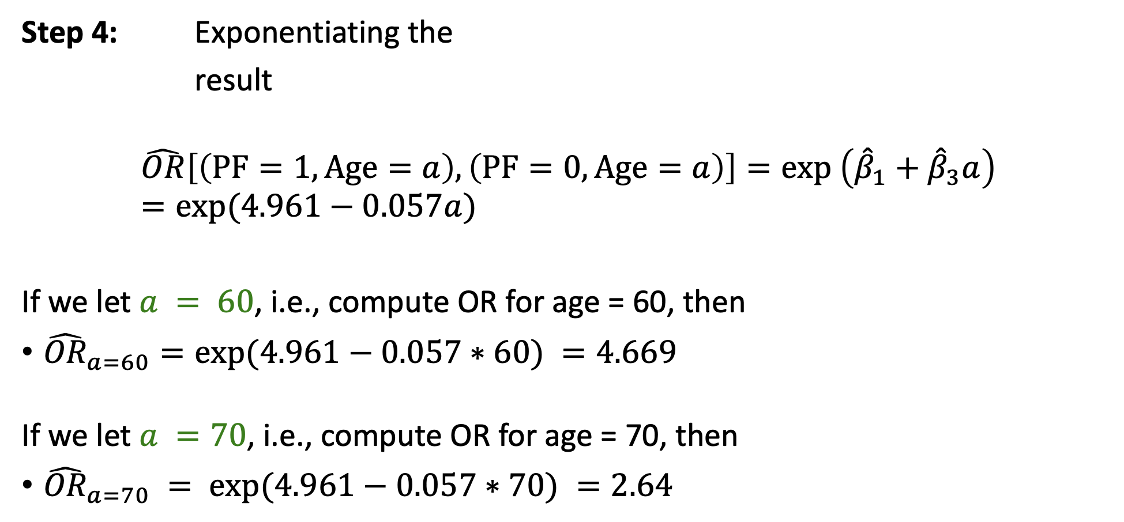
Example: GLOW – Step 4
Step 4: Exponentiating the
result
$$\hat{OR}\left[\left(PF=1, Age=a\right),\left(PF=0, Age=a\right)\right]=exp \left({\hat{β}}_{1}+{\hat{β}}_{3}a\right)=exp⁡(4.961−0.057a)$$
If we let $a = 60$, i.e., compute OR for age = 60, then
${\hat{OR}}_{a=60}=exp⁡(4.961−0.057∗60) =4.669$
If we let $a =70$, i.e., compute OR for age = 70, then
${\hat{OR}}_{a=70} = exp⁡(4.961−0.057∗70) =2.64$
$${\hat{β}}_{1}$$
$${\hat{β}}_{2}$$
$${\hat{β}}_{3}$$
$${\hat{β}}_{0}$$

Slide 43
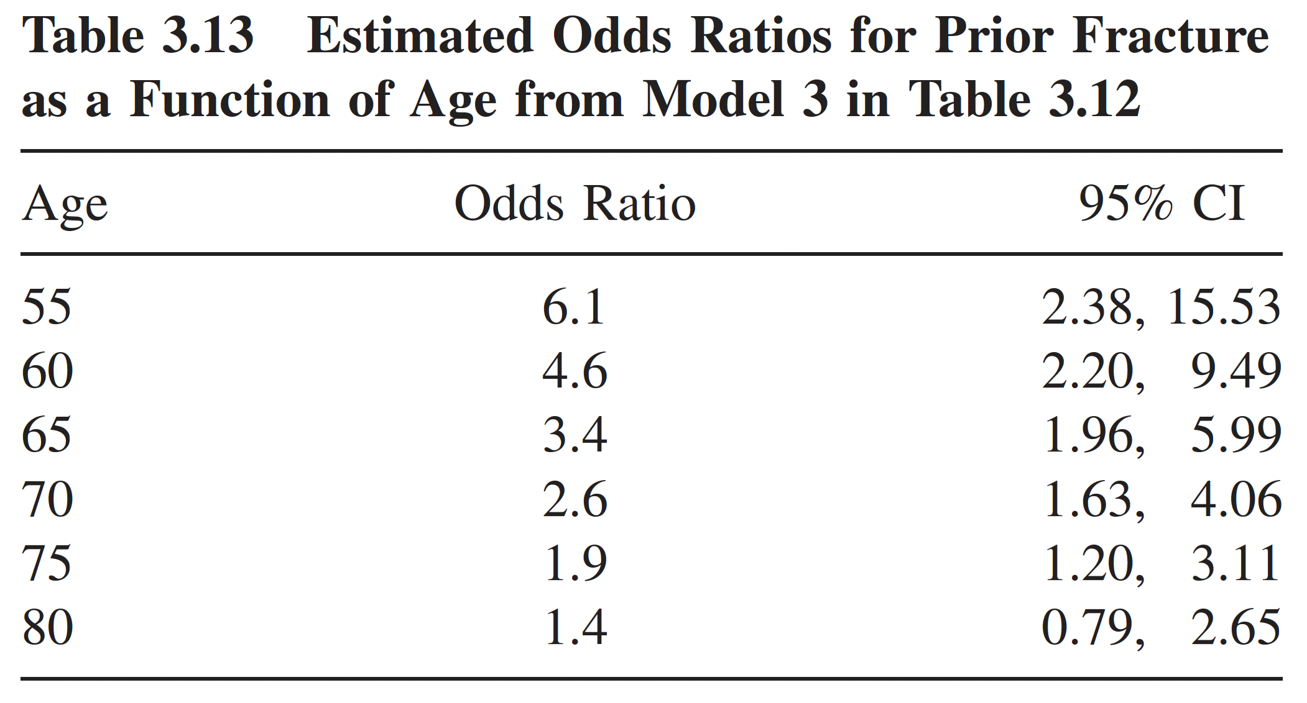
Example: GLOW – Table of ORs
Sometimes a Table listing the estimated odds ratio and 95% CI at different value of X will also be helpful and informative
Table from Hosmer & Lemeshow, page 77

Slide 44
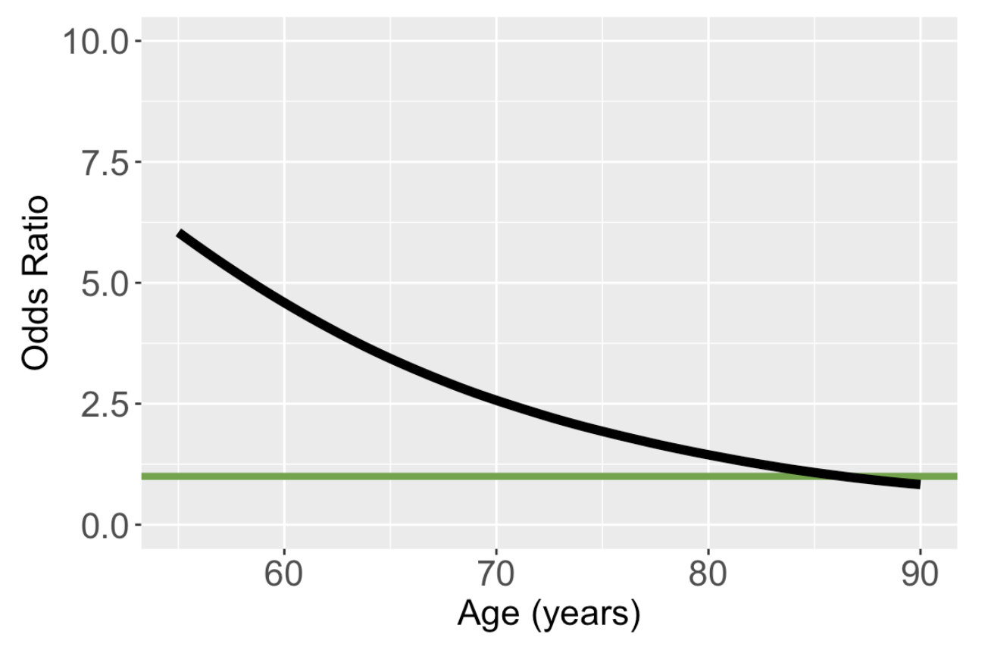
Plot of Odds Ratio Involving Interaction Term
Odds ratio comparing prior fracture to no prior fracture

Slide 45
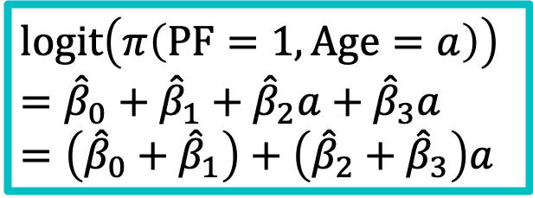
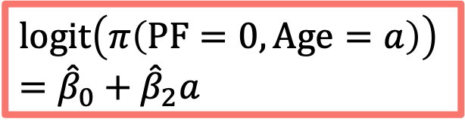
Graphically Showing Interaction Revisited
One easy way to see the nature of the interaction between F and X is to plot the two logit functions
Using the GLOW fracture example:
$$logit\left(π\left(PF=1, Age=a\right)\right)={\hat{β}}_{0}+{\hat{β}}_{1}+{\hat{β}}_{2}a+{\hat{β}}_{3}a=\left({\hat{β}}_{0}+{\hat{β}}_{1}\right)+\left({\hat{β}}_{2}+{\hat{β}}_{3}\right)a$$
$$logit\left(π\left(PF=0, Age=a\right)\right) \\ ={\hat{β}}_{0}+{\hat{β}}_{2}a$$

Slide 46
Poll Everywhere Question 6

Slide 47
Class 9 Learning Objectives
Determine if an additional independent variable is a not a confounder nor effect modifier, is a confounder but not effect modifier, or is an effect modifier.
Calculate and interpret odds ratios for interactions
Understand the overall steps for purposeful selection as a model building strategy
Connect these steps back to the tests of coefficients in Class 8

Slide 48
“Successful modeling of a complex data set is part science, part statistical methods, and part experience and common sense.”
Hosmer, Lemeshow, and Sturdivant Textbook, pg. 101

Slide 49
Purposeful Selection
Model building strategy
Adding one more model building tool into our toolbox
You don’t necessarily need to use this one
We can use this strategy for any type of regression
This is generally how I go about building models
WHEN I am working with a collaborator who has a specific variable (risk factor) of interest
And for association
Keeps model interpretable and helps them publish in an applied medical journal

Slide 50
Nicky’s small tangent about model building
Model building is all about intention for the model
Association and interpretations
Ex: How is age related to fractures?
Prediction
Ex: Will someone who is 55 years old have a fracture?
Our class focuses on association and interpretation
Logistic regression can still be used in prediction, but the model building strategy will be different
Has anyone here heard about Random Forest models?
Uses a group of decision trees to make predicts on a categorical outcome
Binary classification

Slide 51
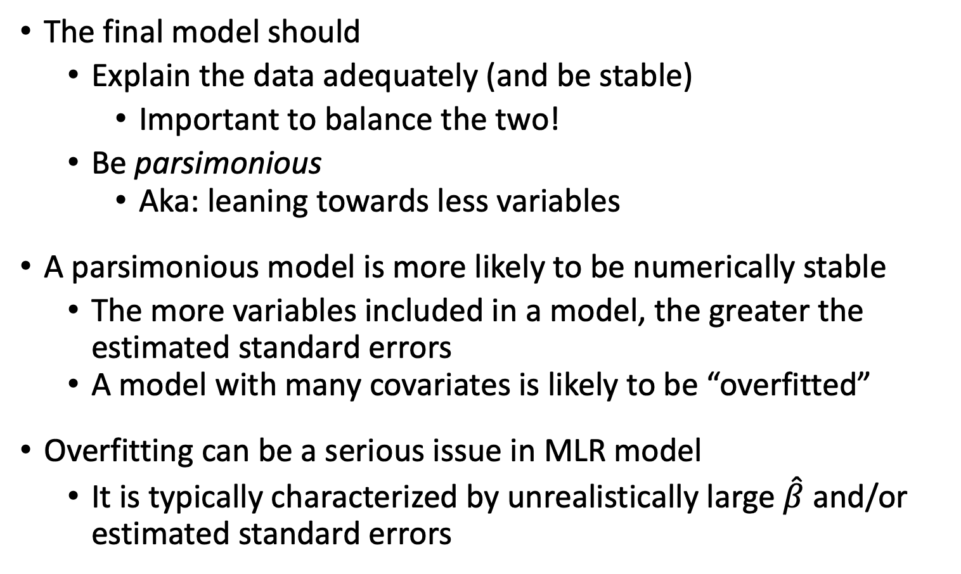
A Good Model is a Parsimonious Model
The final model should
Explain the data adequately (and be stable)
Important to balance the two!
Be parsimonious
Aka: leaning towards less variables
A parsimonious model is more likely to be numerically stable
The more variables included in a model, the greater the estimated standard errors
A model with many covariates is likely to be “overfitted”
Overfitting can be a serious issue in MLR model
It is typically characterized by unrealistically large $\hat{β}$ and/or estimated standard errors
Notes:
A parsimonious model is also more likely to be generalizable

Slide 52
Purposeful Selection Overview
Univariable Analysis
Preliminary Variable Selection
Assess change in coefficients
Add back excluded variables
Assessing scale for continuous variable
Check for Interaction
Assess Model Fit

Slide 53
Step 1: Univariable Analysis (I)
Categorical independent variable
We can use contingency tables, visualizations, or simple logistic regression
Likelihood ratio, Chi-square test, or get odds ratios
Pay attention to zero or small cells, collapse cells as necessary
May need to shift categories
Continuous independent variable
Simple logistics regression models, or two-sample t-test
May also consider a smoothed scatter plot to check linear association, but could wait until step 5

Slide 54
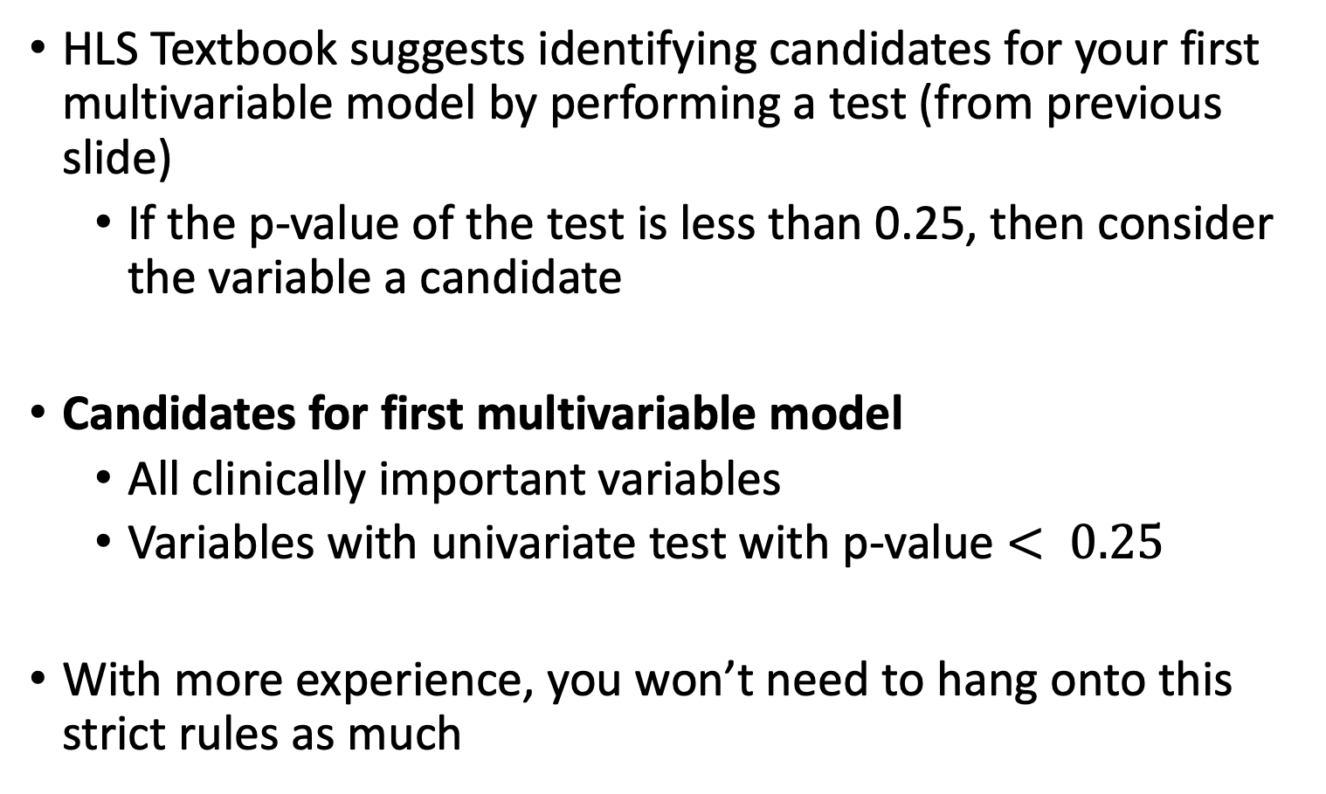
Step 1: Univariable Analysis (II)
HLS Textbook suggests identifying candidates for your first multivariable model by performing a test (from previous slide)
If the p-value of the test is less than 0.25, then consider the variable a candidate
Candidates for first multivariable model
All clinically important variables
Variables with univariate test with p-value $< 0.25$
With more experience, you won’t need to hang onto this strict rules as much

Slide 55
Step 2: Preliminary Variable Selection
Fit an initial model including any independent variable with p-value < 0.25 and clinically important variables
Too restrictive to use p-value < 0.05 here
After fitting initial model, fit a smaller model with only covariates that are significant (p < 0.05 from initial model), and covariates that have strong clinical reasons to stay
Remember, a Wald test is for individual coefficients, not a set of coefficients!!
Compare those two models using Likelihood ratio test
If evidence that smaller model does not fit data well, we need to look at each covariate more
Notes:
May also compare the bigger vs. smaller models using LRT

Slide 56
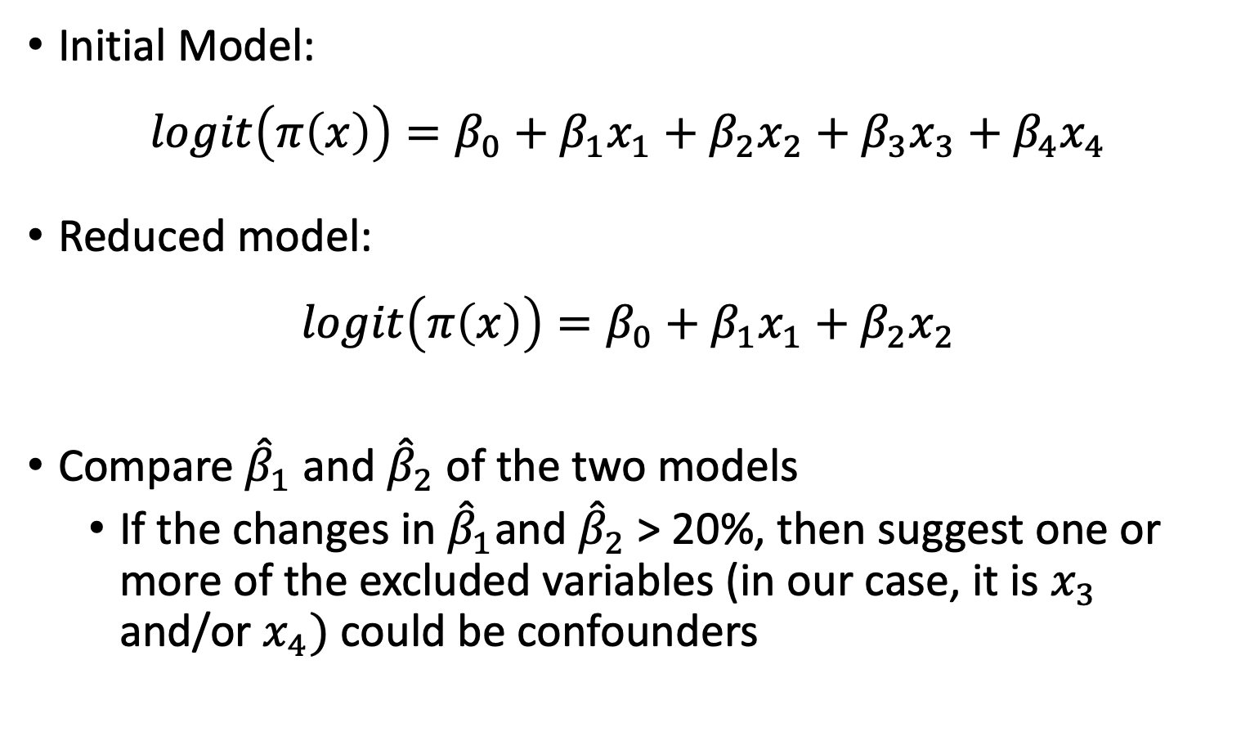
Step 3: Assess change in coefficients in the reduced model (I)
Initial Model:
$$logit\left(π\left(x\right)\right)=β_{0}+β_{1}x_{1}+β_{2}x_{2}+β_{3}x_{3}+β_{4}x_{4}$$
Reduced model:
$$logit\left(π\left(x\right)\right)=β_{0}+β_{1}x_{1}+β_{2}x_{2}$$
Compare ${\hat{β}}_{1}$ and ${\hat{β}}_{2}$ of the two models
If the changes in ${\hat{β}}_{1}$and ${\hat{β}}_{2}$> 20%, then suggest one or more of the excluded variables (in our case, it is $x_{3}$ and/or $x_{4})$ could be confounders

Slide 57
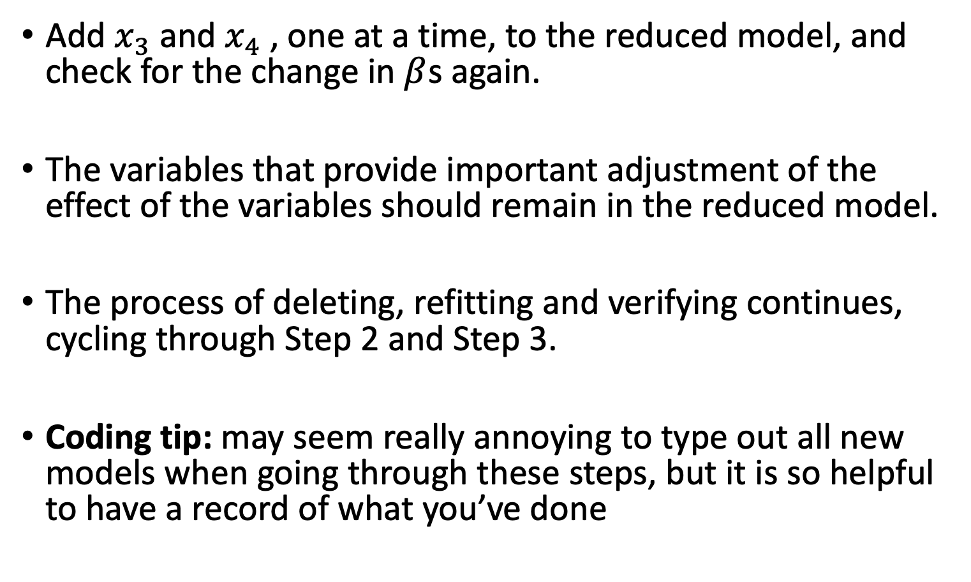
Step 3: Assess change in coefficients in the reduced model (II)
Add $x_{3}$and $x_{4}$, one at a time, to the reduced model, and check for the change in $β$s again.
The variables that provide important adjustment of the effect of the variables should remain in the reduced model.
The process of deleting, refitting and verifying continues, cycling through Step 2 and Step 3.
Coding tip: may seem really annoying to type out all new models when going through these steps, but it is so helpful to have a record of what you’ve done

Slide 58
Step 4: Add back excluded variables to reduced model
At the concluding of the cycle of Step 2 and 3, there might be a few variables that you think should go back in the model
Adding those now – add each one individually!
Check Wald p-value for significance
Or use LRT if categorical variable with more than two levels
To identify variables that are not significant alone but are significant in the presence of other variables.
The model at the end of Step 4 is the preliminary main effects model.

Slide 59
Step 5: Assessing scale for continuous variable
To assess the linearity in the logit for continuous variables in the model.
Details of the methods to be discussed later!
Model at the end of Step 5 is the main effects model.

Slide 60
Step 6: Check for Interactions
Create a list of interaction terms from variables in the “main effects model” that has clinical plausibility
Add the interaction variables, one at a time, to the main effects model, and assess the significance using a likelihood ratio test or Wald test
May keep interaction terms with p-value < 0.05
Keep the main effects untouched, only simplify the interaction terms – locked!
Use methods from Step 2 (comparing model with all interactions to a smaller model with interactions) to determine which interactions to keep
The model by the end of Step 6 is called the preliminary final model

Slide 61
Poll Everywhere Question 7

Slide 62
Step 7: Assess Model Fit
Assess the adequacy of the model and check its fit
Methods will be discussed later
If the model is adequate and fits well, then it is the Final model

Slide 63
Class 9 Learning Objectives
Determine if an additional independent variable is a not a confounder nor effect modifier, is a confounder but not effect modifier, or is an effect modifier.
Calculate and interpret odds ratios for interactions
Understand the overall steps for purposeful selection as a model building strategy
Connect these steps back to the tests of coefficients in Class 8

Slide 64

Wrap-up
4-minute exit ticket
Next class
Midterm review on Monday
Important concepts
Practice problems
Midterm next Wednesday!
We will go through a model building example
https://forms.office.com/r/YJ6wcNFGBK

